Slide 1
Memory Representation
of
“Non Primitive Data Structure”
Arrays,RMA & CMA

Slide 2
Memory representation of Array
Mainly arrays are categorized in two types:
One dimensional array
Multidimensional array

Slide 3
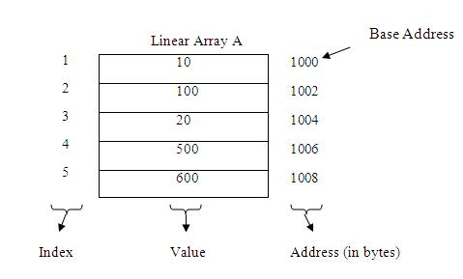
One Dimensional Array :
1-d array are linear array in which elements are stored in the successive memory locations. The element at the very first position in the array is called its base address

Slide 4
Multi Dimensional Array :
In multidimensional arrays the array is divided into rows and columns, mainly while considering multidimensional arrays we will be discussing mainly about two dimensional arrays and a bit about three dimensional arrays.
In 2-D array we can declare an array as :
int arr[3][3];
where first index value shows the number of the rows and second index value shows the no. of the columns in the array.

Slide 5
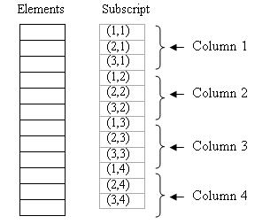
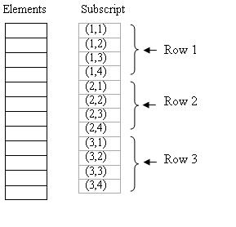

Slide 6
RMA (Robust Multi-array Average)
RMA is an algorithm used to create an expression matrix from Affymetrix data. The raw intensity values are background corrected, log2 transformed and then quantile normalized. Next a linear model is fit to the normalized data to obtain an expression measure for each probe set on each array. RMA is very easy to use in J-Express, a description follows further down on this page. All transformations and normalizations change the data, and it is highly recommended to understand .

Slide 7
CMA(Conformal Microwave Array )
The CMA applicator is an effective thermal therapy device for heating large-area superficial disease such as diffuse chestwall recurrence. It is able to cover over three times the treatment area of conventional hyperthermia devices while conforming to typical body contours.

Slide 8
ThAnKu……….

